Slide 1
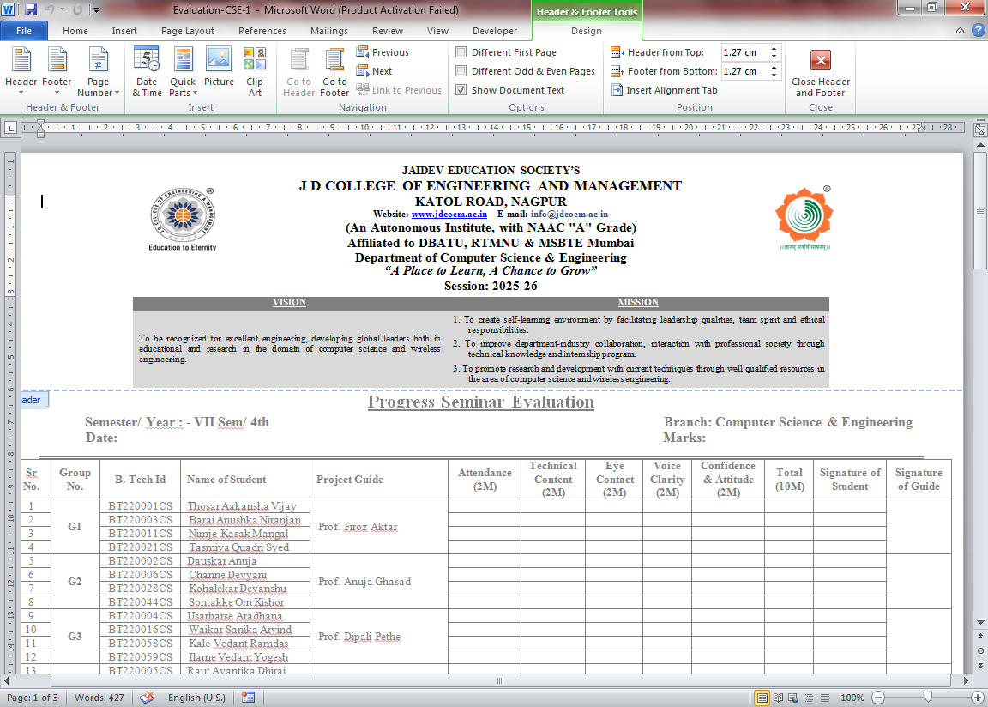
Mini Project
Title: ---------
Under the Guidance of Prof. --------
Designation: Assistant Professor, JDCOEM, Nagpur
Presented by :
1) 3)
2) 4)
April-2025

Slide 2


INDEX
Introduction
Problem definition
Literature Review
Objectives of the study
Limitations
Scope
Methodology
Flow Chart
Implementation
Tools & Techniques
Conclusions (expected )
Publication if any
Patents/Copyright if any
References

Slide 3
Introduction

Slide 4
Problem Definition

Slide 5
Literature Review
Sr. No. | Paper Title | Author | Publication & Year | Key Points
1
2
3
4
5

Slide 6
Literature Review
Sr. No. | Paper Title | Author | Publication & Year | Key Points
6
7
8
9
10

Slide 7
Objectives

Slide 8
Limitations
4/3/2026

Slide 9
Scope

Slide 10
Methodology
4/3/2026

Slide 11
Flow Chart
4/3/2026

Slide 12
Implementation
4/3/2026

Slide 13
Tools & Techniques
4/3/2026

Slide 14
Conclusions (expected )
4/3/2026

Slide 15
References
[1] Fazli Subhan. Alina Mirza, “AI-Enabled Wearable Medical Internet of Things in Healthcare System: A Survey”, MDPI, open access scientific journals Artificial Intelligence and Robotics in Healthcare, 2023.
[2] Rajeswari ChengodenNancy Victor, Thien Huynh, “Metaverse for Healthcare: A Survey on Potential Applications, Challenges and Future Directions” , IEEE Access, 2023.
[3] Joel J. P. C. Rodrigues, “Smart and Wearable Sensors Technologies for Digital Healthcare”, Journal of Sensors, 2022.
[4] Mazin Alshamrani, “IoT and artificial intelligence implementations for remote healthcare monitoring systems: A survey”, Journal of King Saud University-Computer & Information Science, 2022.
[5] Wang, H., Li, D., Li, L., & Cheng, L., “Wearable IoT device for monitoring human vital signs during surgery”, IEEE Internet of Things Journal, 8(9), 7519-7530, 2021.
[6] Feng, Y., Wei, H., Cao, Y., & Cao, J., “IoT-based surgical navigation system using sensors and cameras” , IEEE Transactions on Industrial Informatics, 17(5), 3525-3535, 2021.
[7] Jaber, S., Singh, S., & Lee, U. , “IoT-based system for real-time surgical feedback”, IEEE Transactions on Biomedical Engineering, 68(2), 541-551, 2021.
4/3/2026

Slide 16
Hackathon Certificate
4/3/2026

Slide 17
L & T Certificate
4/3/2026

Slide 18
Thank You!!!
4/3/2026

